Slide 1
Lecture 26:
6.5. The Pace and Meaning of Economic Growth
Brad DeLong
Department of Economics & Blum Center, U.C. Berkeley; & WCEG
last revised: Su 2020-04-12
for presentation: Th 2020-06-06
Original course by Melissa Dell (Harvard Econ 1342), revised by Brad DeLong
<https://github.com/braddelong/public-files/blob/master/econ-135-lecture-26.pptx>

Slide 2
Discussion
The Pace and Meaning of Economic Growth:
What strikes you as important here?

Slide 3
The Pace and Meaning of Economic Growth
26. Tu May 5: 6.5. The Pace and Meaning of Economic Growth:
Readings:
William Nordhaus (1996): Do Real-Output and Real-Wage Measures Capture Reality? <https://www.nber.org/chapters/c6064.pdf>
Edward Bellamy (1887): Looking Backward 2000-1887, selections <https://delong.typepad.com/files/bellamy-backward.pdf>
John Maynard Keynes (1931): Economic Possibilities for Our Grandchildren <https://delong.typepad.com/files/keynes-persuasion.pdf>
Materials:
Readiness:
Slides: <https://github.com/braddelong/public-files/blob/master/econ-135-lecture-26.pptx>
Review:
Discussion:
Text

Slide 4
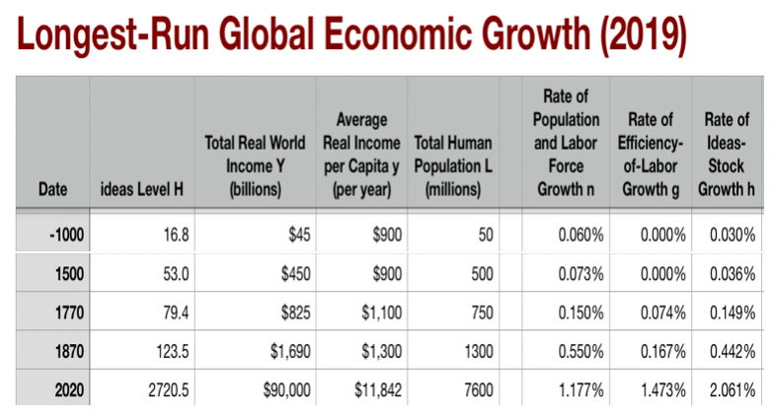

Background: Economic Growth
The eagle’s-eye view:
Three accelerations from agrarian-age norm: x 6.5, x 3.5, x 4.5
I got into this business in the 1980s: Paul Romer then argued a fourth acceleration was on the way
Did not happen (yet?)
5:15 of audio in this slide group; 2:00 here
Notes:
You will recall the eagle’s-eye view of global economic growth we took at the start. The long hunter-gatherer age. Fire, stone tools, language. Then the neolithic revolution, and the invention and discovery of herding and agriculture: cities, literacy, the state, large-scale human organization, command-and-control, and the-market-and-exchange.
This leaves us before the year -1000 with the Malthusian economy of the agrarian age. Typical living standards near (sociologically determined! that “sociologically” is important!) Malthusian subsistence. The rate of growth of the useful ideas stock averaging 0.03% per year—a doubling time of 2300 years. The rate of growth of population about twice that—a doubling time of 1150 years.
Then, dizzyingly, in 1500 the coming of the caravel, the conquest of the “West Indies” by Europeans, the knitting together of Eurasia into a single economic ekumene, the extraordinary intensification of slave raids on Africa, and the imperial age of the Commercial Revolution ratcheting up the pace of growth perhaps 6.5 fold; then in 1770 coal, steam, cotton, iron, and wool and the Industrial Revolution ratcheting up the pace of growth another 3.5-fold; then in 1870 modern economic growth with the industrial research lab, its STEM engineering-practice communities, the corporation, and globalization ratcheting up growth by another 4.5-fold so that now we see in 1 year more relative progress than the agrarian age saw in 50; now our level of useful ideas H stands at 2720 (while it stood at 125 in 1870, at 50 in 1500, at 17 in -1000, and at 1 70000 years ago).
Dizzying.
And back when I got into this business in the early 1980s, the very sharp Paul Romer was then arguing that a fourth acceleration was on the way. It did not happen. Or it did not happen yet.

Slide 5
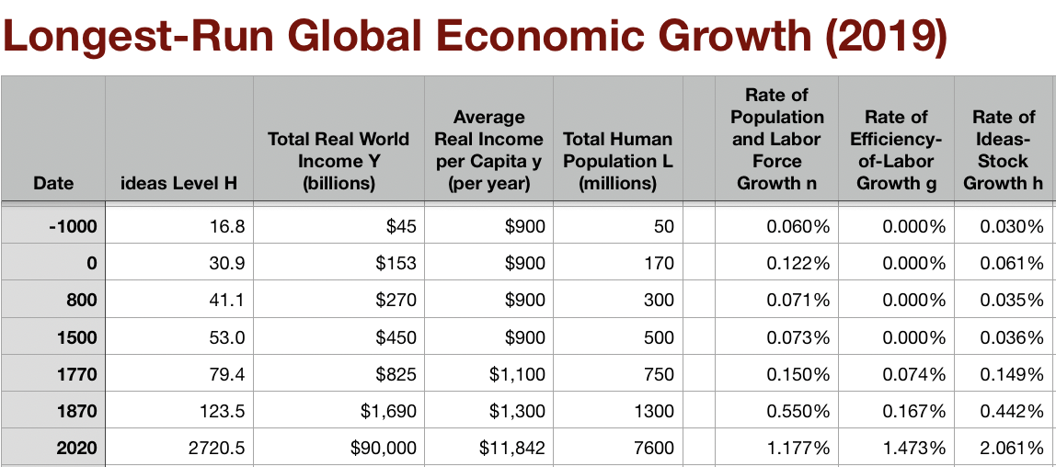
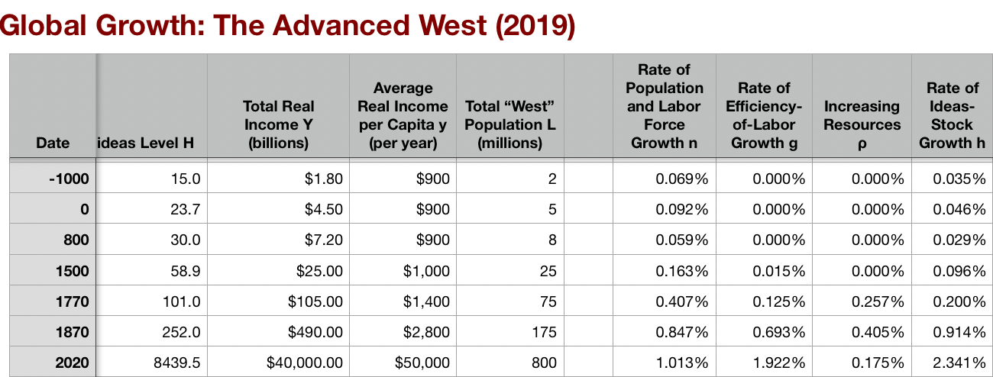
Features of Modern Economic Growth
As conventionally measured:
Ideas growth of 2.1%/yr:
Doubling time of 33 years
More change in one year than in 50 in the agrarian age
Enormous growth in global inequality
Driven by:
Industrial research lab: routinization & rationalization of invention & innovation
Modern corporation: routinization & rationalization of the deployment of ideas
Globalization
Transport
Communications
Migration
Demographic transition
American ascendancy: “the furnace where the future is being forged”
1:15
Notes:
This gives us the world of today, the world of modern economic growth, with its characteristic features.
Worldwide, as conventionally measured, ideas growth of 2.1%/yr: giving us a doubling time of 33 years, and, as I said, more change in one year than in 50 in the agrarian age. It has, as I said, been driven by: (a) the industrial research lab, (b) the resulting routinization & rationalization of invention & innovation in communities of engineering practice that they nurture, (c) the modern corporation with its routinization & rationalization of the deployment of ideas; plus (d) globalization in transport, communications, and—for a while, and to a degree—migration; all in the context of (e) the nearly completed demographic transition.
This long 20th century since 1870 has also seen American ascendancy: “the furnace where the future is being forged” in Leon Trotsky’s phrase. And it has seen enormous growth in global inequality, growth that I still find hard to explain or even to grasp.

Slide 6
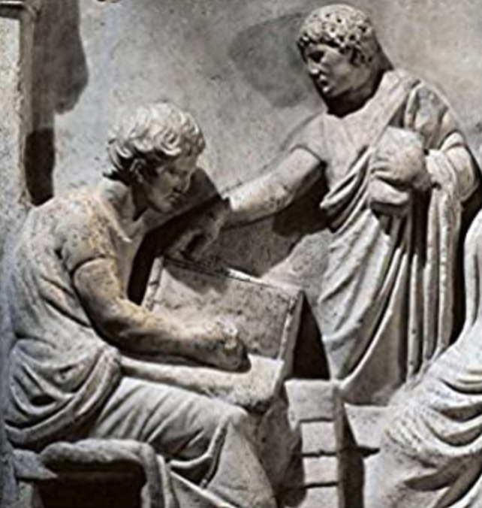
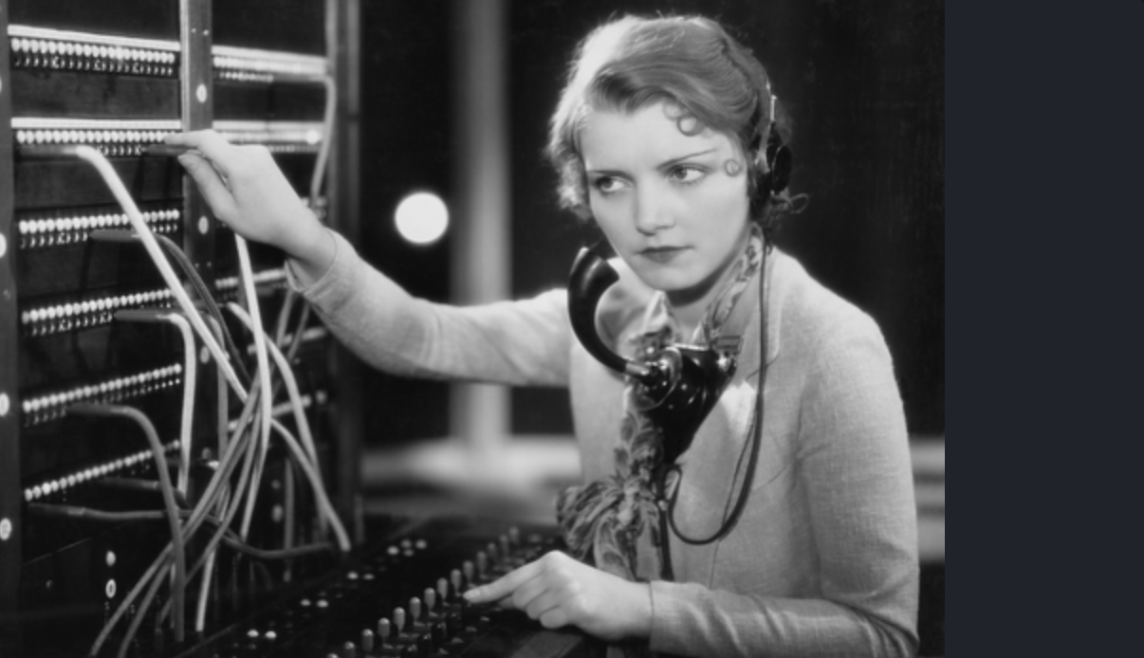
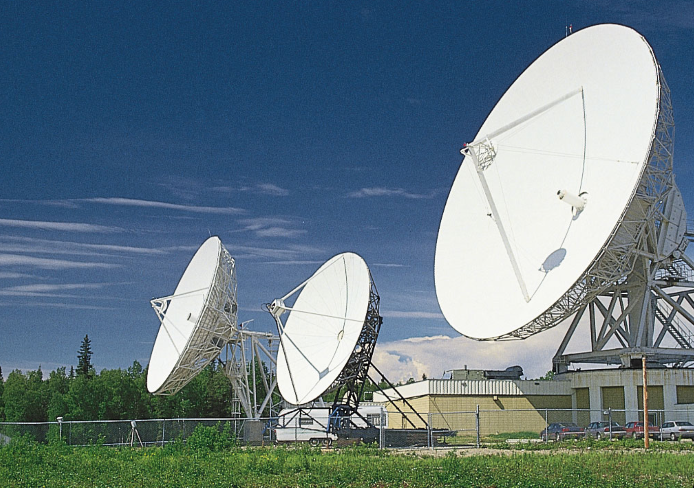
Are These Conventional Measures at All Accurate?
Enormous changes in relative prices:
A short book today trades for 2 lb. of flour
At 25 𐆖 for 100 lines, a short book in the time of Diocletian traded for 250 lb. of flour
And the same in the time of Martial: 1 𐆘/page (note the 40-to-1 inflation)
General labor wage then: 2.5 lbs. flour/day…
General labor wage now: 120 lbs. flour/day
I have 1000 physical books in my sight right now—that’s enough flour in the time of Diocletian or Martial to feed 3 cohorts of the imperial Roman army for a year
Plus there are all the books I have at my virtual fingertips…
Standard statistics say we are only 15 times as rich…
On the physical book standard, a typical California annual household income today would pay the wages of 1,500 men for a year.
On the wheat flour standard, a typical California annual household income today would pay the wages of 50 men for a year.
On the unskilled labor standard, a typical California annual household income today would pay the wages of two unskilled servants for a year.
2:00
Notes:
Today I want to raise the question: might this dizzying picture be an underestimate of the growth acceleration?
Are these conventional measures at all accurate?
We have seen enormous changes in relative prices across the centuries. For example, a short printed book today trades for 2 lb. of flour—maybe not today, when flour sells out at the Orinda Safeway on those days they have it by 9:30 AM, but when we are not sheltering in place. But on the other hand, if you have a smartphone and if the book you want is on Project Gutenberg, then a short albeit not printed book has only connectivity, electricity, and battery and charger wear costs—say, 25 cents for consumables and depreciation of the smartphone while you are using it to read the book. That means a book trades for not 2 lbs of flour, but for 1/3 of an ounce of flour.
At a price of 25 denarii for 100 lines, a short book in the time of the Roman Emperor Diocletian in 300 traded for 250 lb. of flour. And it was the same in the time of Martial around 100: then it was 1 sestertius a page (note the 40-to-1 inflation)
The general labor wage then: 2.5 lbs. flour/day, or 0.01 books a day
The general labor wage now: 120 lbs. flour/day, or 60 books a day, or is it
6000?
I have 1000 physical books in my sight right now—that’s enough flour in the time of Diocletian or Martial to feed 3 cohorts of the imperial Roman army for a year. Plus there are all the books I have at my virtual fingertips…
Standard statistics say we are only 15 times as rich.
But on the wheat flour standard, a typical California annual household income today would pay the wages of 50 Roman men for a year.
On the physical book standard, a typical California annual household income today would pay the wages of Roman 1,500 men for a year.
And on the virtual book standard, a typical California annual household income today is 600,000 times as rich
Does 15 grossly underestimate it?

Slide 7
Catch Our Breath…
Ask a couple of questions?
Make a couple of comments?
Any more readings to recommend?
<>

Slide 8
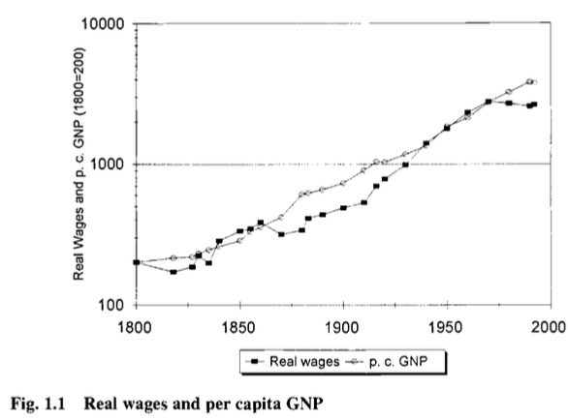
Bill Nordhaus: History of Lighting
William D. Nordhaus. 1997. “Do Real-Output and Real-Wage Measures Capture Reality? The History of Lighting Suggests Not.” In The Economics of New Goods, edited by Timothy F. Bresnahan and Robert J. Gordon. Chicago: University of Chicago Press for NBER, pp. 29– 66. http://www.nber.org/chapters/c6064
Conventional measures: a 15-fold increase in real first-world GDP/capita and productivity
6:45 of audio in this slide group; 0:45 here
Notes:
I had you read Bill Nordhaus on the history of lighting, and then his speculations using the results of his lighting investigations as a springboard. The paper is: William D. Nordhaus. 1997. “Do Real-Output and Real-Wage Measures Capture Reality? The History of Lighting Suggests Not.” In The Economics of New Goods, edited by Timothy F. Bresnahan and Robert J. Gordon. Chicago: University of Chicago Press for NBER, pp. 29– 66. http://www.nber.org/chapters/c6064. It attacks the conventional measure of a 15-fold increase in real first-world GDP/capita and productivity, and it does so stridently, wittily, and—most of the time—I believe it attacks it convincingly.

Slide 9
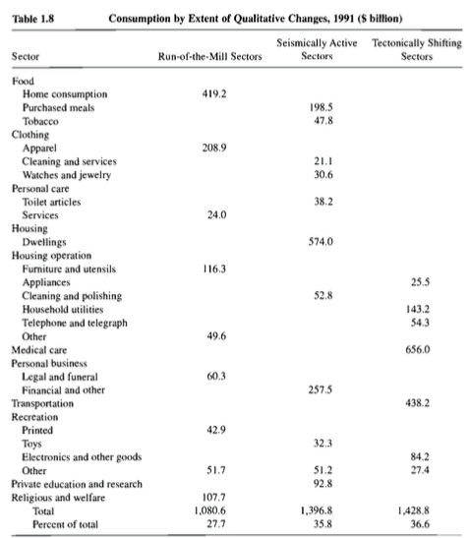
Bill Nordhaus: Rocket Ship to the Singularity?
A 20-fold or a 30,000-fold increase in real wages in the North Atlantic since 1800?
Nordhaus calculates that—back in 1991—28% of consumption was “run-of-the-mill”, 36% had been “seismically-active” since 1800, and 37% was in sectors that had no effective affordable equivalent in 1800
Dixit-Stiglitz tells us that we multiply “ordinary” utilities by the number of varieties. Which way does that mislead us?
1:30
Notes:
Bill Nordhaus—he who now has one of the economic growth Nobel prizes—thinks the “15-fold” number comes from a failure of imagination in constructing our statistics. Economic historians and national income accountants look at the prices of the same goods as they change from year to year. They use them to divide nominal incomes in dollars as they change from year to year. They get resulting estimates of real incomes from year to year. But what set of commodities do they look at? And what do they do when a new commodity enters the mix of things people buy?
Well, they periodically adjust the baskets of goods they look at in order to try to keep them roughly representative of what people are buying. And when they re-weight their baskets, sometimes they add newly invented goods to the mix.
And when they do add new goods, they hope that they have added them early enough in the process that the simple leap that now you can buy not just the old stuff but something new—that that does not in itself boost the utility you gain from your income enough to grossly distort their calculations.
Nordhaus claims that that is wrong. Nordhaus claims when new goods are added to the mix, and when we gain the powers to make new goods and new types of goods, that increase in the range of our choice has been at least as important as the falling real prices in terms of human labor of the goods we have long known how to produce. And he does this by focusing not on what we buy but on the services that what we buy performs for us. And he focuses on one service: lighting.

Slide 10
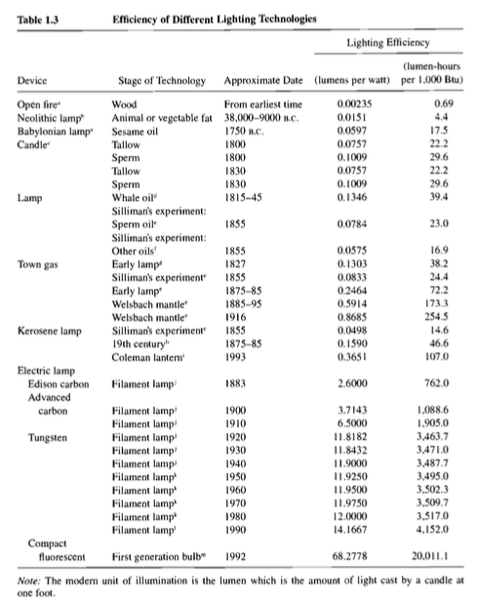
Bill Nordhaus: Rocket Ship to the Singularity? II
A 5000-fold decrease in the price of light since 1800
This is something that churned up between 1% and 5% of household budgets back in 1800
100-fold CPI bias in the price of light since 1800
How representative is lighting?
Perhaps 1/3 of what we spend money on produces services in a way that had no reasonable analogue more than two centuries ago
1:00
Notes:
Nordhaus’s calculations get us a 5000-fold decrease in the price of light since 1800. This is something that churned up between 1% and 5% of household budgets back in 1800. He finds a 100-fold bias in the price of light since 1800 when he compares the price recorded in the consumer price index to the true cost in terms of human labor of getting an extra photon bouncing around a room at night.
And he thinks that this example is representative of about 1/3 of what people spend their money on: 1/3 of what we buy give us capabilities that could not have been produced at any price in the past. And we don’t have to go to information goods: perhaps a king of England could have had strawberries grown for him in a greenhouse in midwinter, but probably not—you could do the heat, and you could do the soil, and you could do the water, but you could not do the lighting and you could not reset the plant’s biorhythms. There is a reason that strawberry leaves are a sign of nobility in England.

Slide 11
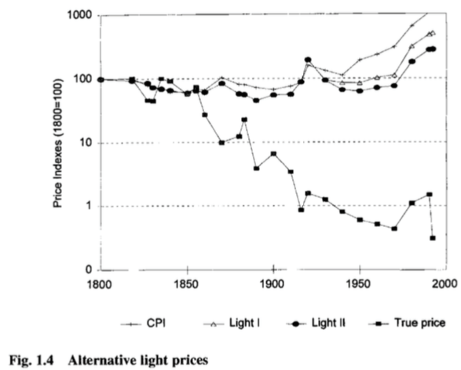
Bill Nordhaus & Adam Smith
Who in the past’s life-chances would you have willingly swapped for yours as they stood at birth?
Adam Smith, TMS:
“in the languor of disease and the weariness of old age, the pleasures of the vain and empty distinctions of greatness disappear…. Power and riches appear then to be, what they are, enormous and operose machines contrived to produce a few trifling conveniencies to the body…though they may save him from some smaller inconveniencies, can protect him from none of the severer inclemencies…. They keep off the summer shower, not the winter storm, but leave him always as much, and sometimes more exposed than before, to anxiety, to fear, and to sorrow; to diseases, to danger, and to death…”
But that is not really true any more, is it?
Being so hungry, so cold, so wet that you almost cannot think of anything else is not a big source of disutility any more, is it? And it used to be.
We are now much less exposed “to sorrow; to diseases, to danger, and to death”
And they are long delayed…
3:30
Notes:
Turn the question around. Is there anybody more than 100 years in the past whose life-chances at birth you would prefer to your own if you could have been switched with them at birth? For me the answer is definitely “no”. I would have been dead several times from pneumonia if I had been born before 1940, and thus before antibiotics. As I said before: Nathan Mayer Rothschild, richest man in the world in the first half of the nineteenth century, dead in his fifties and tortured by doctors for months beforehand as they tried and failed to cure an infected abscess in his butt—something that would get you five minutes of treatment at the Tang Center and five minutes only.
Or suppose you want to watch a spooky movie this evening in your room. Well, you could browse the “Scream Scene” podcast and pick from any of a wide variety of things for pennies. Four hundred years ago, if you wanted to watch it in your house, what were your options? Well, it had to be MacBeth. And you had to be James I, King of England, Scotland, and Ireland. Only he, you see, had Shakespeare’s acting company on retainer, and a large enough home theater.
Or turn it around again. Suppose you were a typical, even a rich and powerful person in the past. Is there anyone born today whose life-chances at birth you would not switch with? You might well be given pause by the people living in boxes on Telegraph Avenue. But perhaps in an earlier century they are the people who would have been chained up in Bedlam Hospital if their families had tired of them. And we have antipsychotics, that mostly work, for people who can be persuaded to stay on their meds.
Otherwise? You have to very much value bossing people around to accept the dangers of life. Adam Smith said that pre-modern wealth was not really worth very much at all, in the big picture:
>In the languor of disease and the weariness of old age, the pleasures of the vain and empty distinctions of greatness disappear…. In his heart he curses ambition, and vainly regrets the ease and the indolence of youth, pleasures which are fled for ever, and which he has foolishly sacrificed for what… can afford him no real satisfaction. In this miserable aspect does greatness appear to every man when reduced either by spleen or disease to observe with attention his own situation, and to consider what it is that is really wanting to his happiness. Power and riches appear then to be, what they are, enormous and operose machines contrived to produce a few trifling conveniencies…. They keep off the summer shower, not the winter storm, but leave him always as much, and sometimes more exposed than before, to anxiety, to fear, and to sorrow; to diseases, to danger, and to death…
Well, we have not conquered death or disease or sorrow. But we have much less to be anxious about and to fear—we have much more ability to control nature and the idea that we will be truly short of true necessities is something that is for the most part simply out of our minds. Much of our wealth does not banish but does reduce our exposure to and greatly lengthen the time before we must face disease, danger, sorrow, and death.

Slide 12
Catch Our Breath…
Ask a couple of questions?
Make a couple of comments?
Any more readings to recommend?
<>

Slide 13


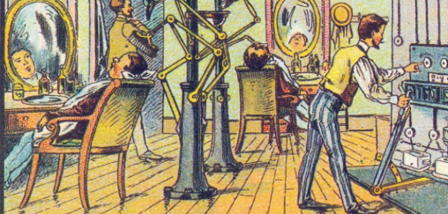
Keynes’s Economic Possibilities for Our Grandchildren
Written in a time of trouble:
Faulty banking and monetary system
Preventing the needed decline in the interest rate
Yet waste and confusion only 7.5% of national income
Reasonable expectations of life in 2130 are utopian
The pace of progress depended on:
The demographic transition
International and civil war
Science!
Investment
Lack of pre-1700 progress due to lack of technology and lack of investment
Now we have both
11:00 of audio in this slide group; 3:00 here
Notes:
John Maynard Keynes was one of those who thought that the advance of science and of society would—or at least should—bring us to utopia. In his mind the quantitative measure of human prosperity was much less important than the fact, he believed, that progress would soon—in a century or so—give us “enough”.
This was not that Keynes thought everything was rosy back in 1931 when he wrote his “grandchildren” essay and gave it as a talk. He spent his life trying to avoid and then cure great depressions and analogous macroeconomic evils. At the moment he wrote his “grandchildren” essay, the world was suffering from a very bad attack of economic pessimism. At the moment he wrote his “grandchildren” essay, the flaws in the banking and monetary system—and in its political regulation—had produced an economic and a human disaster. Prosperity required, in the situation as it was then, a steep decline in the rate of interest. The banking and the monetary and the poiltical systems were working to prevent that decline. And the result was what we call the: “Great Depression”.
Yet even so—dysfunctional finance, monetary system, and politics doing their worst—the damage that was done was, Keynes believed, to enforce a reduction of actual prosperity 7.5% below full-employment potential. The Great Depression was to grow twice as great: 15% rather than 7.5%. And so Keynes’s expectation that 7.5% was as bad as it would get was wrong. Yet it looks as though he was right about the long run: his expectation that life in 2130 would be much more prosperous was a reasonable and a sound one. His utopian hopes? We will get to those later.
Keynes said the pace of progress depanded on four things: the successsful completion of the demographic transition to permanently banish from earth what Keynes called the “Malthusian devil”; achieving an end to or at least a reduction in international and civil wars; the advance of science; and a healthy rate of investment to allow the application of the findings of science. If these were favorable, progress would be swift. If these were not, it would be slow.
But Keynes believed, the lack of pre-1770 progress had been due to a lack of science to advance technology and a lack of investment to put the benefits potentially flowing from the advance of knowledge to work. In the then-modern year of 1930 Keynes thought: “now we have both…”
The pictures on the right of the slide were drawn for the 1900 World Exhibition in Paris. Search Wikidedia Commons for the category “France in XXI Century (fiction)”. That resource has 54 of the 87 or more originally made. And as images of an imagined steampunk future, I think they are quite dope.

Slide 14
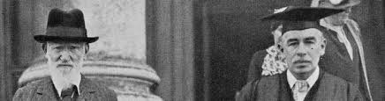
Here We Have Keynes Being Very Wrong
“Almost everything which really matters… [in 1770] was already known… at the dawn of history…”:
“…Language, fire, the same domestic animals which we have to-day, wheat, barley, the vine and the olive, the plough, the wheel, the oar, the sail, leather, linen and cloth, bricks and pots, gold and silver, copper, tin, and lead—and iron was added to the list before 1000 B.C.—banking, statecraft, mathematics, astronomy, and religion…”
But: H from 1 (70K years ago) to 5 (10k years ago) to 17 (3K years ago) to 53 in 1500, 79 in 1770, 123 in 1870, 2720 today
Or is Keynes wrong—especially as he starts with “language, fire”?
George Bernard Shaw & John Maynard Keynes leaving Cambridge, England’s Fitzwilliam Museum in the mid-1930s
3:00
Notes:
And here in the “grandchildren” essay we find Keynes saying something very wrong—that:
>Almost everything which really matters… [in 1770] was already known… at the dawn of history. Language, fire, the same domestic animals which we have to-day, wheat, barley, the vine and the olive, the plough, the wheel, the oar, the sail, leather, linen and cloth, bricks and pots, gold and silver, copper, tin, and lead—and iron was added to the list before 1000 B.C.—banking, statecraft, mathematics, astronomy, and religion…
We, by contrast, say: Not so. We say: But our index H—our quantitative measure of the real value of he useful ideas stock—known to humans and diffused around the world that we set equal to 1 back 70,000 years ago grows to 5 10,000 years ago, to 17 3000 years ago, and then to 53 in the year 1500 and 79 in 1770, the date Keynes set as the commencement of the modern age. It then grows to 123 in 1870 and stands at 2720 today. It will grow much larger: that 2720 is a measure not just of what the forefront of humanity knows but of how broadly and widely that knowledge is distributed, and it is far from evenly distributed around the world.
There was a huge amount of progress in inventing and applying technologies for manipulating nature and organizing humans between when history dawned, whenever you take that to be, and 1770. Just saying “iron” really does not cut it as far as the ability to produce useful stuff out of substances that contain the element with atomic number 26 is concerned. That the overwhelming bulk of these improvements went into allowing our natural resources to support many more of us rather than granting a typical human an easier life was all about how we used our potential wealth, not what our potential wealth was.
Or maybe Keynes is right. After all, he starts his list with “language, fire” which were our collective property 70,000 years ago. Remove those, and we have an H that I would guess is not one but 0.1. And maybe we should look at progress on a log scale, multiplicatively rather than arithmetically. Then dawn-of-time to 1770 is 17/0.1 = 170. 1770 to 2020 is then only 2720/17 = 170.
The picture shows aged playwright George Bernard Shaw and John Maynard Keynes leaving Cambridge, England’s Fitzwilliam Museum in the mid-1930s after a formal academic event there.

Slide 15
The Force of Exponential Growth
In the long run mankind is solving the economic problem:
A standard of life in 2030 four to eight times higher than seen in 1930…
Absolute needs are satiable…
And should be satiated sooner than most of us expect
The relative need for superiority may well be insatiable…
The economic problem has been humanity’s biggest problem for all of history:
So people have worked hard to be more productive
So people have figured out how to take stuff from others
What will life be like after the economic problem?
2:45
Notes:
At the core of Keynes’s argument is that he has seized hold of the idea of positive exponential growth—not linear growth, not polynomial, not logistic, but exponential growth. And he has been carried away by its possibilities. For the force of exponential growth is, in the long run, irresistible. For a long time, you see, exponential growth appears to do next to nothing. Then in a very short period of time everything is transformed. And then, in a short time after that, things pass beyond our previous measures and experience into something completely incomprehensible.
No positive exponential growth process continues forever—except possibly the expansion of the universe. The question is always: will it utterly transform things before it shifts us immeasurably beyond and out of our frame of reference? And Keynes, writing in 1930, thinks it is about to.
Therefore his conclusion: In the long run mankind is solving the economic problem—and the long run is not very long. He anticipates a standard of life in 2030 four to eight times higher than seen in 1930. (And he was right.)
Then Keynes reasons like this: Absolute needs are satiable. And absolute needs should be satiated sooner than most of us expect. After all, what do we want? Champagne; port, walnuts, and stilton cheese; a roaring fire; soft cushions to sit on and witty friends to talk to; perhaps a radio for entertainment and as an up-to-the-minute news source. Those, Keynes thinks, are easy and straightforward to provide in a world as rich as he in 1930 thought compound growth would produce by 2030.
He then dismisses relative needs with “the relative need for superiority may well be insatiable…” And he does not consider material wealth and display as a way of satisfying those relative needs—for him, superiority will be demonstrated by acting in a superior way, and not by having more things in one’s pile. Superiority as a way of commanding others and power over commodities as a way of getting them to obey—he misses that. (Was he right here?)
This leads to his conclusion: While “the economic problem has been humanity’s biggest problem for all of history”, this is, because of exponential growth, in a short period going to stop. In the past and in Keynes’s present, people have worked hard to be more productive. And people have figured out how to take stuff from others.
But in the future there will be no real point in doing so.
So Keynes asks himself: what will life be like after the economic problem?

Slide 16
After the Economic Problem
Keynes has reflections:
Our impulses, our instincts, and our institutions are all built to deal—one way or another—with the economic problem
Is there a problem in how people will find meaning in their lives when the spur of necessity is no longer there to make people feel useful?
Man will be faced with his real, his permanent problem:
How to use his freedom which science and compound interest will have won for him
How to live wisely and agreeably and well.
To judge from the behaviour and the achievements of the wealthy classes to-day in any quarter of the world, the outlook is very depressing!
“I see us free… [to] once more value ends above means and prefer the good to the useful… honour those who can teach us how to pluck the hour and the day virtuously and well…”
“But beware!… For at least another hundred years… foul is useful and fair is not:
Avarice and usury and precaution must be our gods for a little longer still
Only they can lead us out of the tunnel of economic necessity into daylight
2:15
Notes:
And so we come to Keynes’s reflections:
Our impulses, our instincts, and our institutions are all built to deal—one way or another—with the economic problem
This means there may be another big problem on the horizon. How will people will find meaning in their lives when the spur of necessity is no longer there to make people feel useful? Society is not set up to help them find meaning. Society does not train people into how to find meaning. Indeed, everything about society goes against the grain of helping people face a situation of abundance.
And so, Keynes thinks, “Man will be faced with his real, his permanent problem”, and will face it without assistance from society, from its institutions, from customary patterns, and from his—it is definitely “him” here—education and upbringing. What is the permanent problem? It is:
“How to use his freedom which science and compound interest will have won for him. How to live wisely and agreeably and well.”
And here Keynes gets snarky. He says: “To judge from the behaviour and the achievements of the wealthy classes to-day in any quarter of the world, the outlook is very depressing!” Acting like the drunken louts he sees Britain’s idle rich as being dismays him—yet that is how people who are not under the spur of having to earn a living behave. Everyone behaving like the Kardashians, 24/7/365.
So Keynes tries to paint a more optimistic picture: “I see us free… [to] once more value ends above means and prefer the good to the useful… honour those who can teach us how to pluck the hour and the day virtuously and well…”
But then he closes with: This is for 100 years from now. This is not for today. We still, Keynes thought in 1930, need to work and save and accumulate: “But beware!… For at least another hundred years… foul is useful and fair is not: Avarice and usury and precaution must be our gods for a little longer still. Only they can lead us out of the tunnel of economic necessity into daylight…”
(Was he right?)
And if he was right, what would he expect us to be doing if he could see us now?

Slide 17
Catch Our Breath…
Ask a couple of questions?
Make a couple of comments?
Any more readings to recommend?
<>

Slide 18
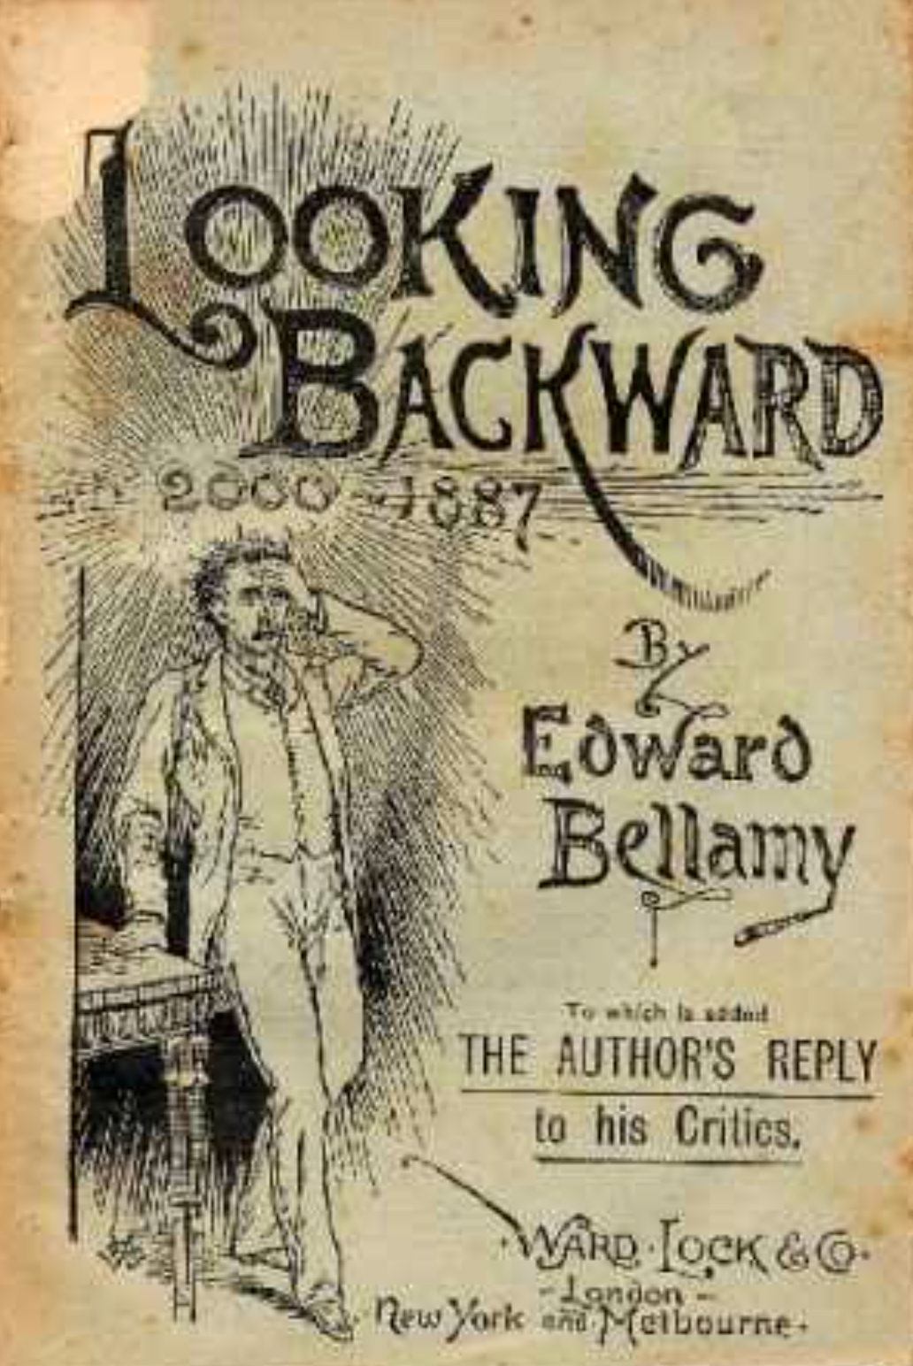
“Do You Like Music?”
Perhaps a better way to approach this question…
Looking Backward, Edward Bellamy’s 1887 utopian novel.
Narrator in 2000 hears the question (p. 87): “Are you fond of music?”
He expects his hostess to play the piano—a social accomplishment of upper-class women around 1900.
It would have cost the average worker roughly a year at a 50-hour workweek to earn the money to buy a high-quality piano,
And then there would be the expense and the time committed to piano lessons.
But today, to listen to music-on-demand in your home, all you need is… your smartphone…
8:15 of audio in this slide group; 1:00 here
Notes:
Perhaps there is a better way than doing math in which to grasp the magnitude of the contribution that the changing set and mass of goods and services we can produce makes to our wealth.
Let us try reading Looking Backward, Edward Bellamy’s 1887 utopian novel. In Looking Backward the narrator—thrown forward in time from 1895 to 2000 by an unbelievable and crude plot device—hears the question (p. 87): “Are you fond of music?”
He expects his hostess to play the piano—a social accomplishment of upper-class women around 1900. To listen to music on demand then, you had to have—in your house or nearby—an instrument, and someone trained to play it. It would have cost the average worker some 2400 hours, roughly a year at a 50-hour workweek, to earn the money to buy a high-quality piano. And then there would be the expense and the time committed to piano lessons. But today, to listen to music-on-demand in your home, all you need is… your smartphone…

Slide 19

Labor-Time Values
A Steinway piano labor-time price:
2400 average worker-hours in 1870
1000 average worker-hours today.
But the capability of listening to music at home:
2400 average worker-hours a century ago
What today? 5 hours?
And then there is variety, and quality
x 2 or x 500?
1:00 audio
Notes:
The labor-time value of a Steinway piano has fallen in price from roughly 2400 average worker-hours a century ago to roughly 1000 average worker-hours today.
But if what you value is not the piano itself but the capability of listening to music at home, the cost has fallen from 2400 average worker-hours a century ago to… what? Maybe 5 hours?
So when we calculate the increase in material wealth, do we count the halving of the labor-time price of the commodity (which is what Historical Statistics does); or do we count the 500-fold decrease in the real labor-time price of the capability of listening to piano music? The experiences of live and recorded music are different in kind. But are they different enough to put a serious dent in the fact that a household today can acquire the capability of listening to piano music for only 1/500 the labor time cost of a household of a century ago?
And whose piano playing do you really want to listen to? Just your hostess’s? Or do you wish access to the entire universe of recorded and streaming sound?

Slide 20
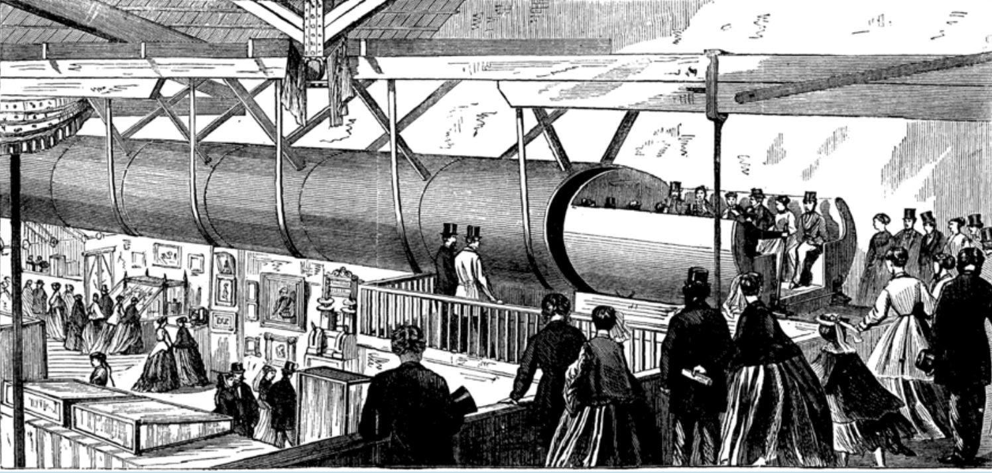
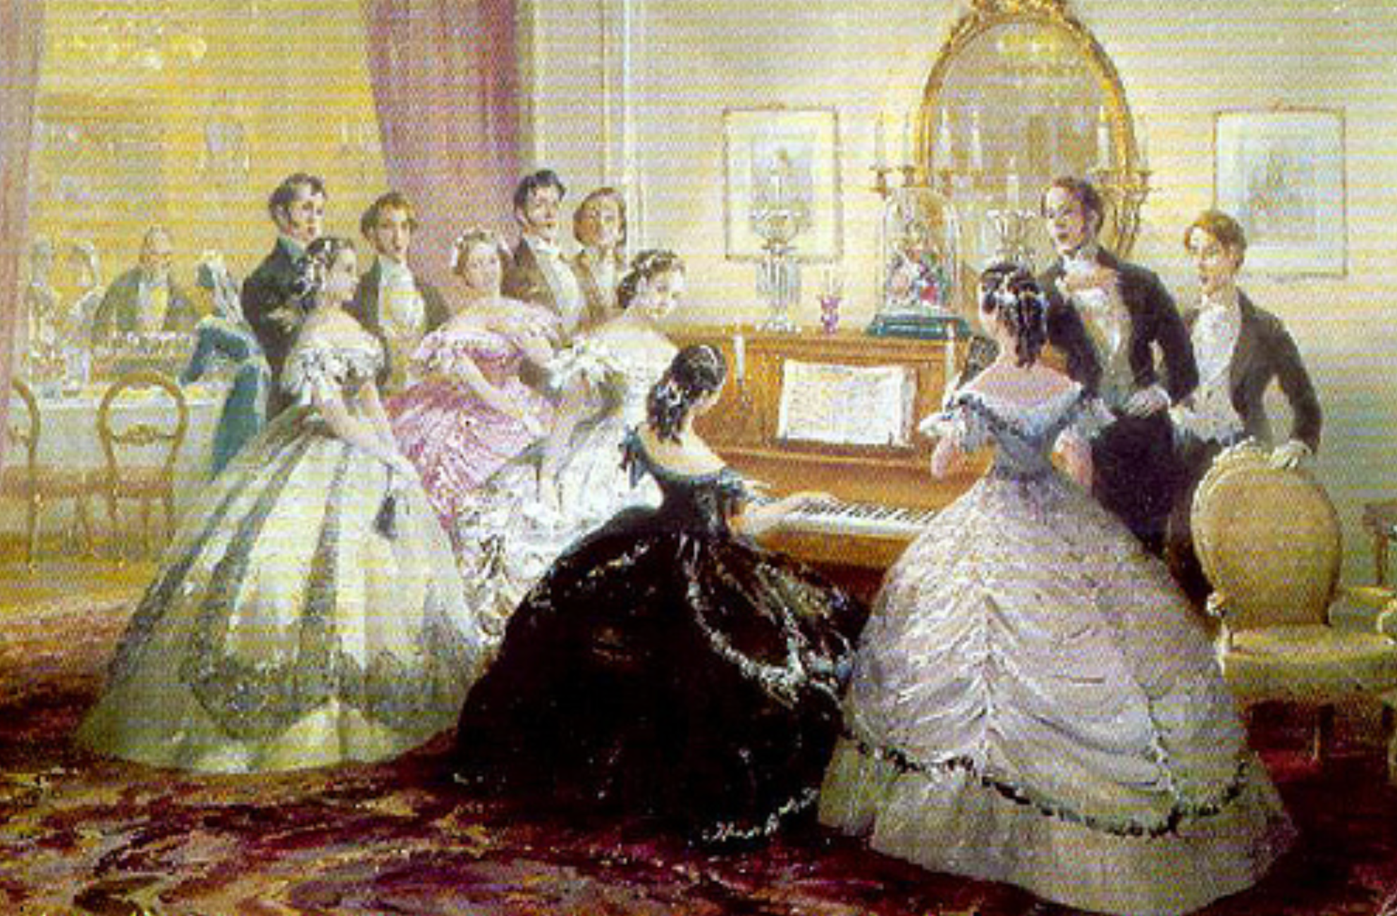
“The Limit of Human Felicity…”
Bellamy’s protagonist in the year 2000 is then stupefied
His hostess “merely touched one or two screws…”
She calls the orchestra and puts it on the speakerphone.
Bellamy’s protagonist then says (p. 90):
If we [in the 1800s] could have devised an arrangement for providing everybody with music in their homes, perfect in quality, unlimited in quantity, suited to every mood, and beginning and ceasing at will, we should have considered the limit of human felicity already attained…
To Edward Bellamy—a self-described utopian visionary—a radio that could tune into any of four stations is “the limit of human felicity.”
1:15 audio
Notes:
After answering “yes” to the question “would you like to hear some music?” Bellamy’s protagonist in the magical and prosperous year 2000 is then stupefied.
He finds that, instead of sitting down at the pianoforte, his hostess
>merely touched one or two screws… and immediately the room was 'filled with music; filled, not flooded, for, by some means, the volume of melody had been perfectly graduated to the size of the apartment. “Grand!” I cried. ‘Bach must be at the keys of that organ; but where is the organ?’ (pp. 88-89)
He learns that his hostess has called the orchestra on the telephone—for in Bellamy's utopia you can dial one of four orchestras, and then put it on the speakerphone.
Bellamy’s protagonist then says (p. 90):
>If we [in the late 1800s] could have devised an arrangement for providing everybody with music in their homes, perfect in quality, unlimited in quantity, suited to every mood, and beginning and ceasing at will, we should have considered the limit of human felicity already attained…
To Edward Bellamy—a self-described utopian visionary, a late-nineteenth century minister’s son from western Massachusetts—a radio that could tune into any of four stations is “the limit of human felicity.”
Think of that. The limit of human felicity.

Slide 21
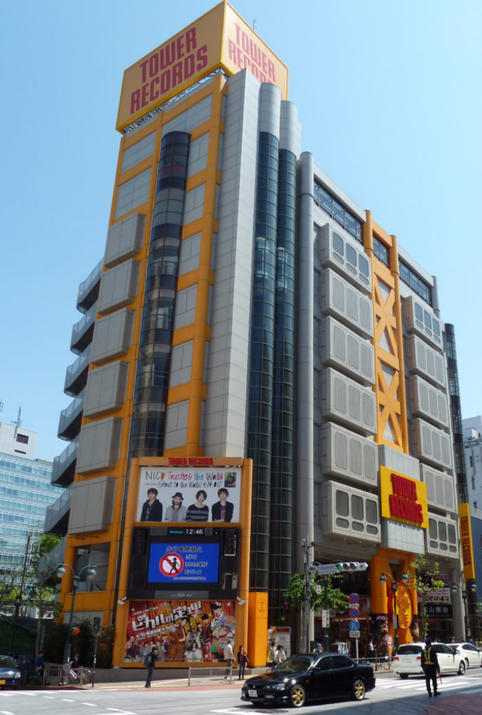
Tower Records
What if someone were to take Edward Bellamy to Tower Records?
Ooops.
Well, if we could have taken Edward Bellamy to Tower Records when it existed, his heart would have stopped.
And now?
Yet we do not think of our modern ability to cheaply listen to high-fidelity go-anywhere listen-to-anything music as a remarkable or even a notable part of our economy. We did not daily give thanks for our CD collections—back when we had CD collections.
We in the North Atlantic today do not reflect that via our smartphone music functions we have been brought to “the limit of human felicity…”
But Edward Bellamy would think that we have…
1:00 audio
Notes:
What if someone were to take Edward Bellamy to Tower Records?
Ooops.
There is no Tower Records anymore, because it was creatively destroyed a generation ago by an alternative and even cheaper and more efficient systems of distribution.
Well, if we could have taken Edward Bellamy to Tower Records back when it existed, his heart would have stopped.
And now?
Yet we do not think of our modern ability to cheaply listen to high-fidelity go-anywhere listen-to-anything music as a remarkable or even a notable part of our economy. We do not daily give thanks for our CD collections and genuflect in front of our iPods. We in the North Atlantic today do not reflect that we have been brought to “the limit of human felicity…”
But Edward Bellamy would think that we have…

Slide 22
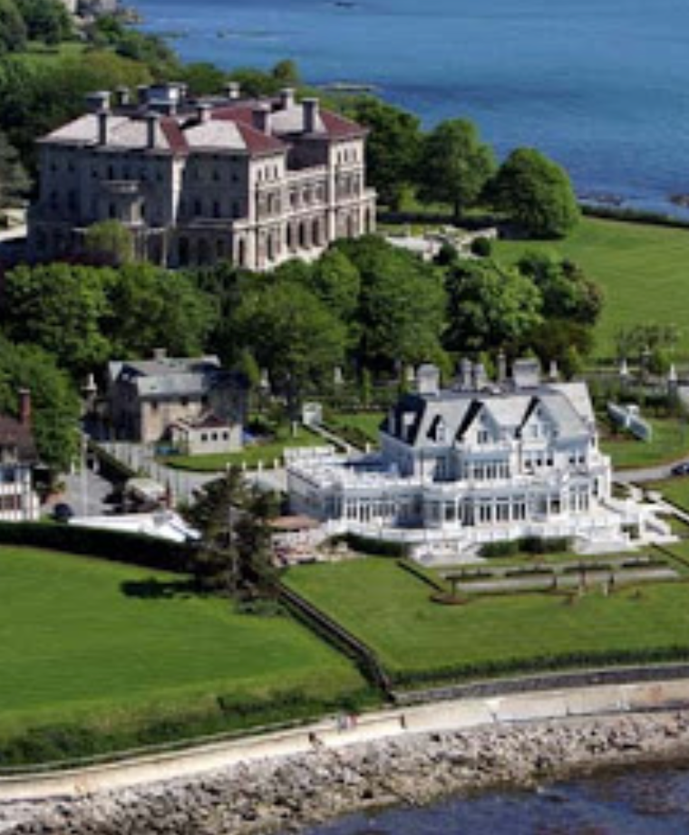
William Nordhaus, Not Quite Among the 400, and Nathan Meyer Rothschild
We have been brought back to William Nordhaus’s argument that our commodity-focused price indices miss most of the real action
Nordhaus guesses that standard estimates understate “true” economic growth since 1800 by between 0.5% and 1.4% per year
An amount that cumulates to a multiplicative factor of between 3 and 21 over the past two centuries
In addition to the 16-fold increase of standard statistics
A factor between 50 and 350.
Is this credible?
I have no problem at all with it…
The death of Nathan Meyer Rothschild
Making the switch…
4:00 audio
Notes:
The argument that our commodity-focused price indices miss most of the real action—that price indices focusing on the services provided would produce vastly greater estimates of long-run economic growth—is made most powerfully by William Nordhaus (1996) in his study of the economic cost of light.
Nordhaus attempts to construct a consistent series of the real labor-time cost of illumination from the dawn of civilization until today. He concludes that the past hundred years have seen a ten thousand-fold decline in the real price of illumination. Yet the commodity-based price indices economists rely on have only captured a ten-fold decline in this real price. Nordhaus guesses that standard estimates understate “true” economic growth since 1800 by between 0.5% and 1.4% per year—an amount that cumulates to a multiplicative factor… of … what?
0.5% x 220 = 1.10; 1.4% x 220 = 3, taking exponentials, of between 3 and 21 over the past two centuries, and to a conclusion that real wages since 1900 have multiplied by a factor between 50 and 350.
Is this credible?
I have no problem at all with Nordhaus’s conclusion. My family’s income today is roughly $400,000 a year—about eight times median earnings per worker. Suppose that you stuffed me and my family into a time machine, sent us back a century to 1890, and then gave us an income equal to 50 times that of 1890 median per worker. We would not be among the 400 invited to the most exclusive parties in the mansions of Newport Rhode Island; but we would be among the next outer circle of 2,000 or so.
Would we then feel as rich as we feel now? Would we be happy—or at least not unhappy—with the switch?
Our power to purchase some commodities would be vastly increased: we would have at least three live-in servants, a fifteen-room house (plus a summer place), if we lived in San Francisco we would live on Nob Hill, if we lived in Boston we would live on Beacon Hill, if we lived in New York we would live on Park or Fifth Avenue.
The answer is surely that we would not be happy and we would feel poor (although if you compared yourself to other people in 1890, you would feel very rich). I would want, first, health insurance: the ability to go to the doctor and be treated with early 21st-century medicines. Franklin Delano Roosevelt was crippled by polio. Nathan Meyer Rothschild—the richest man in the world in the first half of the nineteenth century—died of an infected abscess in his mid-fifties and never saw his grandchildren grow up. Without antibiotic and adrenaline shots I would now be dead of childhood pneumonia.
The second thing I would want would be utility hookups: electricity and gas, central heating, and consumer appliances. The third thing I would want to buy is access to information: audio and video broadcasts, recorded music, computing power, and access to databases.
None of these were available at any price back in 1890.
I could substitute other purchases for some. I could not buy a washing machine, but I could (and would) hire a live-in laundress to do the household's washing—if I were rich enough. I could not buy airplane tickets; I could make sure that when I did travel by long distance train and boat I could do so first class, so that even though travel churned up enormous amounts of time it would be time spent relatively pleasantly. But I could do nothing for medical care: no matter how rich I was, I would be poor. And I could do little or nothing for access to information, communications, and entertainment technology save to spend the equivalent of $1000 on books I can now buy for $30, and to leave the children home with the servants and go to the opera and the theater every other week: no matter how rich I was, I would be poor.

Slide 23
Catch Our Breath…
Ask a couple of questions?
Make a couple of comments?
Any more readings to recommend?
<>

Slide 24
Big Ideas: Lecture 26: The Pace and Meaning of Economic Growth
Takeaways from this lecture:

Slide 25
Roadmap…
7. Conclusion
27. Th May 7: 7.1. The Future?
Read Before: Robert Allen (2011): Global Economic History: A Very Short Introduction, selections <https://delong.typepad.com/files/allen-geh.pdf>

Slide 26
Catch Our Breath…
Ask a couple of questions?
Make a couple of comments?
Any more readings to recommend?

Slide 27
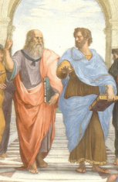
Notes, etc.…

Slide 28
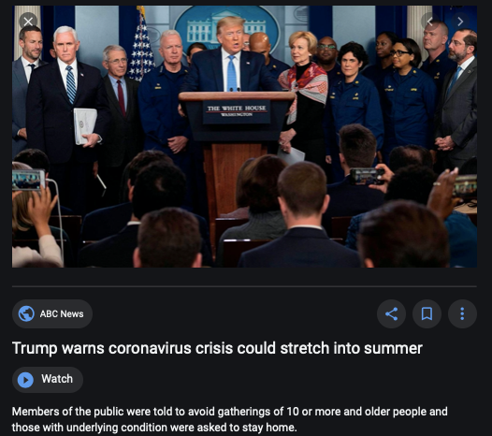
Coronavirus!

Slide 29
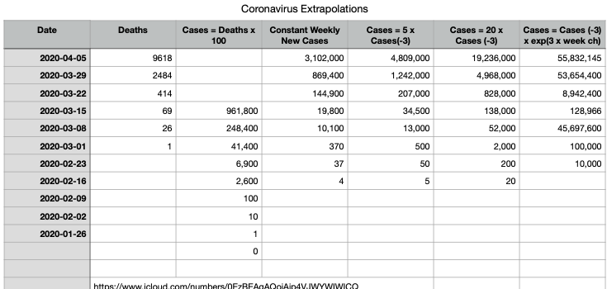
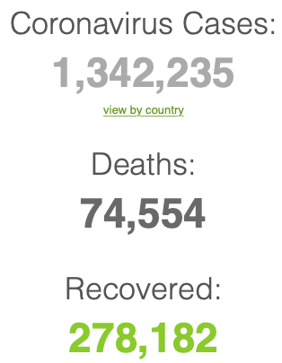
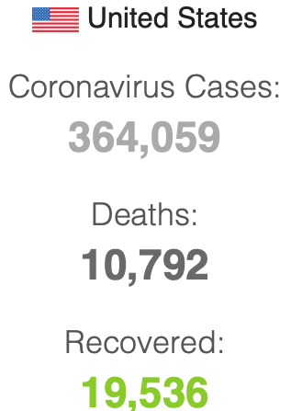

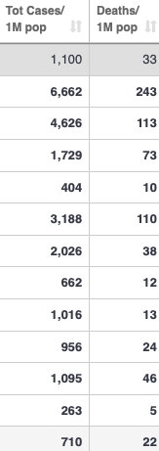
Coronavirus
Where we think we are, as of Th Apr 09:
We really do not know
No random samples…
If we extrapolate out the past week straight-line log:
We will have 440,000 deaths in three weeks
But it is unlikely to be that bad
Best thing I have read comes from Jim Stock <https://drive.google.com/file/d/12MV466ZZy5xHir4xdPhoTrL1oO8CbZU-/view>:
The basic SIR epidemiological model of contagion
The effect of social distancing and business shutdowns on epidemic dynamics enters the model through a single parameter: the case transmission rate β
Re-express the model in terms of β and the asymptomatic (or not very symptomatic) hence non-tested rate—the fraction of the infected who are not tested
The COVID-19 non-testing rate is unidentified in our model
Estimates in the epidemiological literature range from 0.18 to 0.86.
The asymptomatic rate could be estimated accurately and quickly by testing a random sample
The optimal policy response and its economic consequences hinge critically on the asymptomatic rate

Slide 30
Coronavirus II
We do not really know where we are, as of Mo Apr 6:
Best thing I have read comes from Jim Stock <https://drive.google.com/file/d/12MV466ZZy5xHir4xdPhoTrL1oO8CbZU-/view>:
The basic SIR epidemiological model of contagion
The effect of social distancing and business shutdowns on epidemic dynamics enters the model through a single parameter: the case transmission rate β
Re-express the model in terms of β and the asymptomatic (or not very symptomatic) hence non-tested rate—the fraction of the infected who are not tested
The COVID-19 non-testing rate is unidentified in our model
Estimates in the epidemiological literature range from 0.18 to 0.86.
The asymptomatic rate could be estimated accurately and quickly by testing a random sample
The optimal policy response and its economic consequences hinge critically on the asymptomatic rate

Slide 34

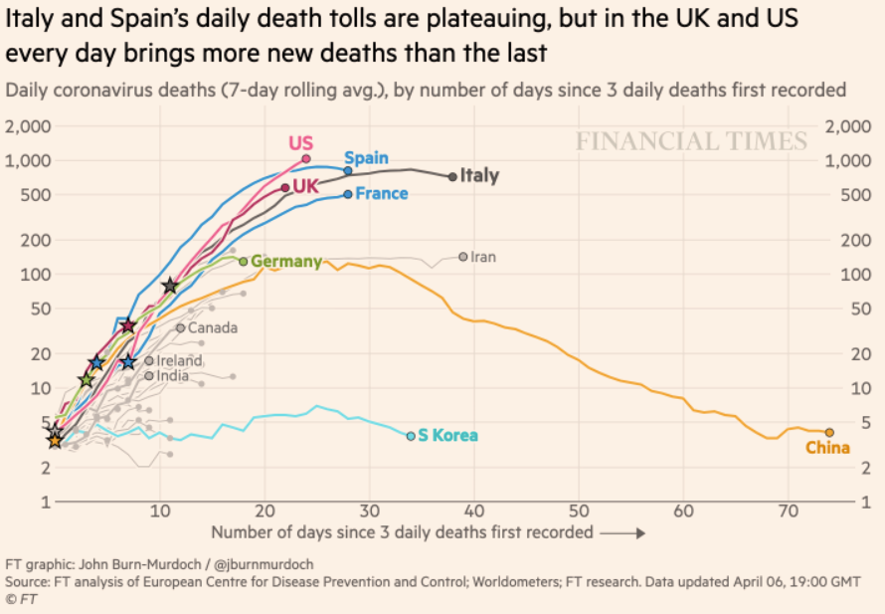
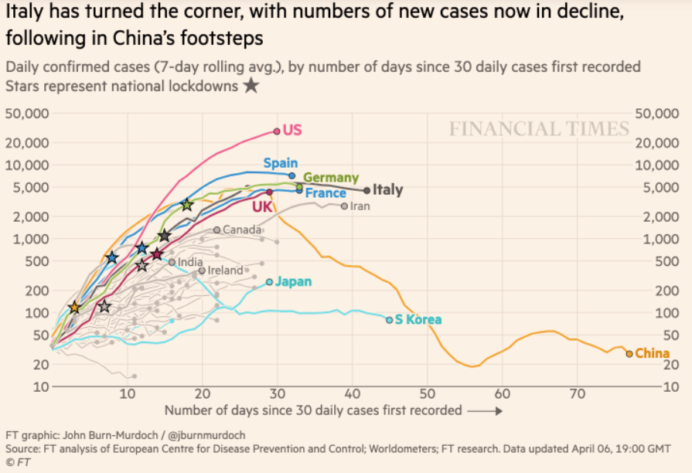
Financial Times Graphs Blown Up…

Slide 38

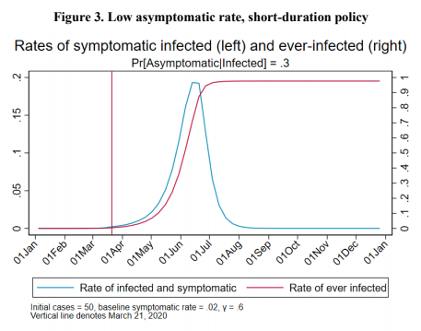
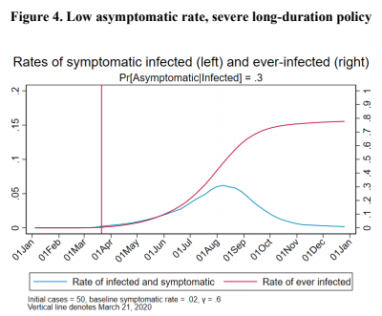
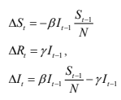
James Stock (2020)
Standard SIR model:<https://drive.google.com/file/d/12MV466ZZy5xHir4xdPhoTrL1oO8CbZU-/view>:
Susceptible, Infected, Recovered (& immune), transmission rate β, recovery rate γ, reproduction number R0, asymptomatic hence non-tested rate π0
Calibration: half-life of infection one week: γ = 0.5, s0 = 0.02, 50 cases on Jan 24
For March 21, 2020, the positive test rate in the United States is approximately 10%…
<https://drive.google.com/file/d/12MV466ZZy5xHir4xdPhoTrL1oO8CbZU-/view>

Slide 43
Bringing the Economy Back Up from Anæsthesia
Major issues:
Certificates of immunity:
Which requires test, test, test:
And not just disease virus tests
Presence-of-antibodies tests
How quickly can we match the immune with public-contact jobs?
What jobs can be done with minimal infection risk?
What minimal-infection substitutes can we find for previous jobs?
How quickly can restrictions be relaxed without the virus coming roaring back?
How do we avoid having the market give a “shutdown” signal to enterprises we in fact want restarted?
Which is pretty much all of them
How much of the potential caseload do we want to push out beyond the vaccine-arrival date?
ALL THESE QUESTIONS ARE ANSWERABLE IF WE LEARN THE ASYMPTOMATIC HENCE NON-TESTED RATE!!

Slide 44
Keeping the Economy from Crashing During the Lockdown
Nick Rowe: We have a 50% output cut in 100% of the sectors:
A temporary 100% output cut in 50% of the sectors (what the Coronavirus does) is very different from a 50% output cut in 100% of the sectors
Nick’s thought experiment:
In three months we are going to invent unobtanium:
Substantial intertemporal substitutibility
Plus lower cross-good contemporaneous substitutitbility
Hence high desired savings rate now
Flex-price market thus produces a nominal rate at the zero lower bound and a high inflation rate over the next three to six months
Plus liquidity-constrained workers in affected sectors see their demand go to zero immediately
Can we get there? Should we get there? What should we do instead?
We need a good RBC economist: are there any?…
<https://worthwhile.typepad.com/worthwhile_canadian_initi/2020/03/relative-supply-shocks-unobtainium-walras-law-and-the-coronavirus.html>

Slide 45
Keeping the Economy from Crashing During the Lockdown II
Nick Rowe:
<https://worthwhile.typepad.com/worthwhile_canadian_initi/2020/03/relative-supply-shocks-unobtainium-walras-law-and-the-coronavirus.html>
Plus: to extend the thought experiment:
We just lost the ability to make “unobtainium”
So we should be substituting leisure for work, and moving workers into relatively unproductive labor, making the commodities we can still produce right now
How should relative prices move as a result? How should we make them move?
Plus: distributional issues
Plus: bankruptcy and credit chain issues

Slide 46
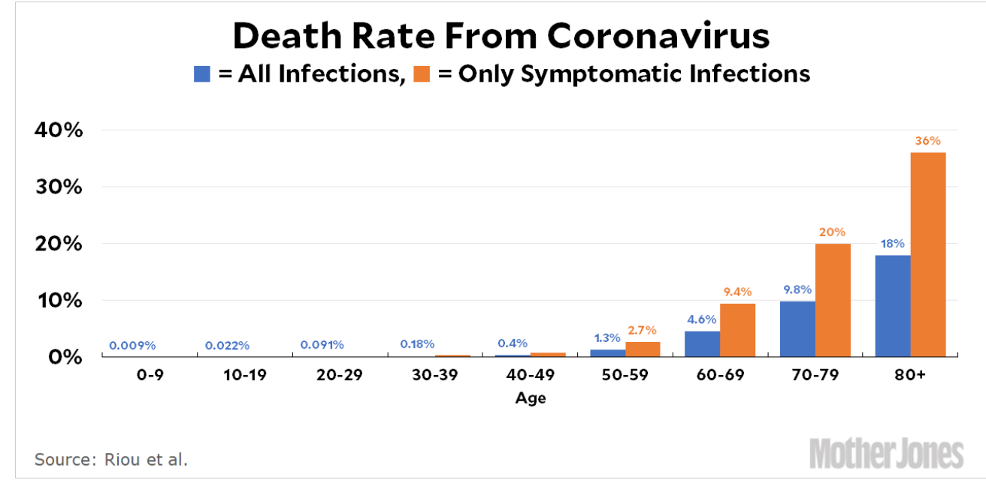
MOAR Coronavirus!
Death for Geezers!
Mortality for the Youngs very low…
It’s the flu for them—for you…
And an extra doubling—or is it 5%?—mortality for the asthmatic
And an extra doubling—or is it 5%?—mortality for the overweight

Slide 47
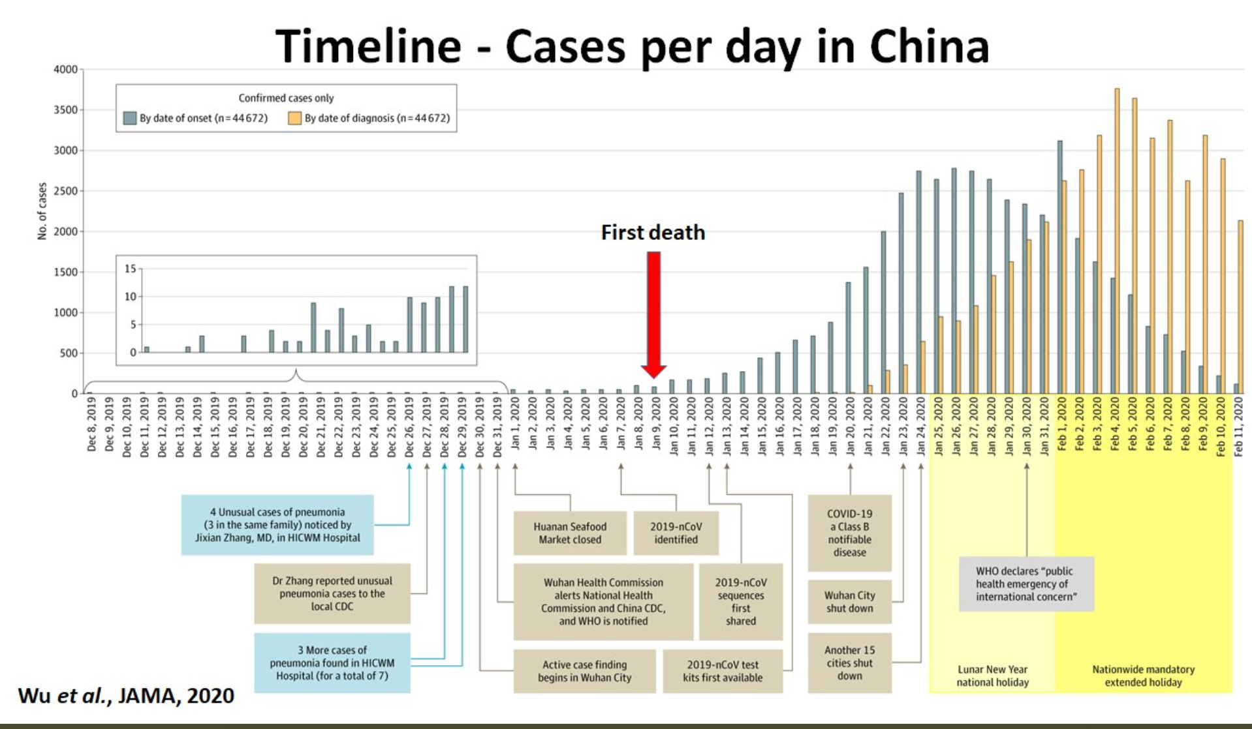
What We Think Happened in Wuhan
China beat it quickly & relatively easily!
We think
Shut down Wuhan when 200 cases per day
That seems to have been a good decision

Slide 48
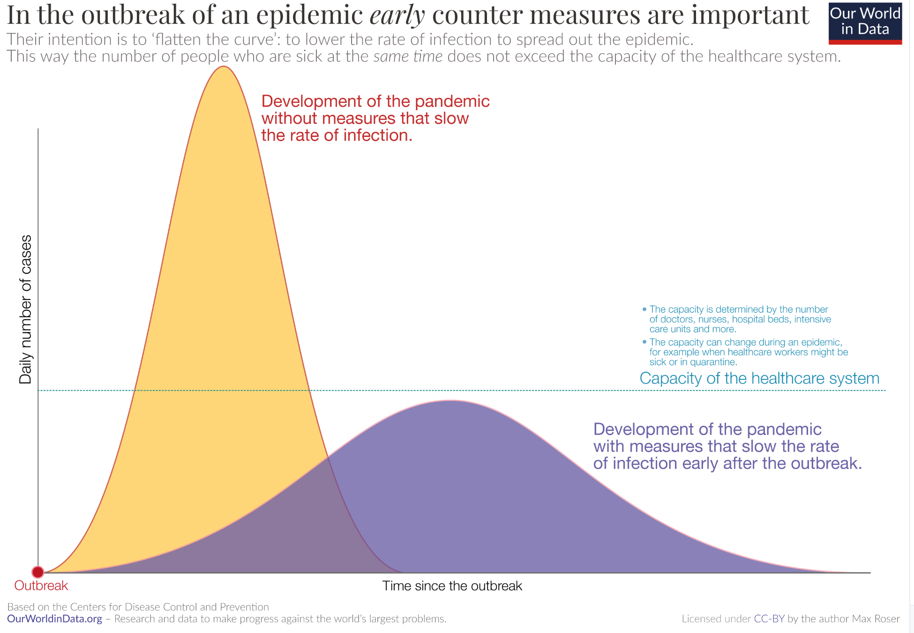
The Goal
When Is It Appropriate to Move on This?
Immediate social distancing…
Self-isolate if you have a cough and a fever…
Hope that warmer temperatures will do to this what they did to SARS…
Otherwise, when do you want to start spreading out transmission. It seems that early is as good as later, so do it early…
I have no good intuition on why you want to move early
Plus your moving early will be wasted if you get reinfected
Plus the sparks you throw off making others’ lives more difficult

Slide 49
References
Financial Times (2020): Coronavirus Tracked: The Latest Figures as the Pandemic Spreads <https://www.ft.com/coronavirus-latest>
Nick Rowe (2020): Relative Supply Shocks, Unobtainium, Walras' Law, and the Coronavirus <https://worthwhile.typepad.com/worthwhile_canadian_initi/2020/03/relative-supply-shocks-unobtainium-walras-law-and-the-coronavirus.html>
Jim Stock (2020): Coronavirus Data Gaps and the Policy Response <https://drive.google.com/file/d/12MV466ZZy5xHir4xdPhoTrL1oO8CbZU-/view>

Slide 50
MOAR Coronavirus!
What I am watching:
Max Roser & Hannah Ritchie: Coronavirus Disease (COVID-19) <https://ourworldindata.org/coronavirus>…
Worldometer: Coronavirus Update (Live) <https://www.worldometers.info/coronavirus/>: ‘125,599 Cases and 4,605 Deaths from COVID-19 Virus Outbreak…
FT Coronavirus Tracker <https://www.ft.com/content/a26fbf7e-48f8-11ea-aeb3-955839e06441>
Josh Marshall’s COVID Twitter List <https://twitter.com/i/lists/1233998285779632128>
NEJM Group: Updates on the Covid-19 Pandemic <http://m.n.nejm.org/nl/jsp/m.jsp?c=%40kxNtXckRDOq8oG0jJvAXsIzN4mPECIPhltxoTSdTU9k%3D&cid=DM89089_NEJM_COVID-19_Newsletter&bid=173498255>: 'From the New England Journal of Medicine, NEJM Journal Watch, NEJM Catalyst, and other trusted sources...

Slide 51
Catch Our Breath…
Ask a couple of questions?
Make a couple of comments?
Any more readings to recommend?
<https://www.icloud.com/keynote/0YKEi7HeOrVGvKYtt9FEqH7nA>
<https://www.bradford-delong.com/2020/04/coronavirus.html>
github:<https://github.com/braddelong/public-files/blob/master/coronavirus.pptx>
https://github.com/braddelong/public-files/blob/master/coronavirus.pdf>
html File: <https://www.bradford-delong.com/2020/04/coronavirus.html>
Edit This File: <https://www.typepad.com/site/blogs/6a00e551f08003883400e551f080068834/post/6a00e551f080038834025d9b3bd66a200c/edit>
<https://delong.typepad.com/files/2020-04-01-coronavirus.pdf>

Slide 52
Coronavirus! (March 16)
With 31 deaths in the U.S. as of March 11, a 1% death rate, and up to 4 weeks between infection and death, that means that as of Feb 12 there were 3100 coronavirus cases in the United States.
With 87 deaths in the U.S. as of Mar 16, a 1% death rate, and up to 4 weeks between infection and death, that means that as of Feb 17 there were 8700 coronavirus cases in the United States
If it is doubling every seven days, then now about 150,000 people have and in the next week about 150,000 more people in the U.S. will catch coronavirus—which means 1/2200, currently 3500 of the 7.6 million inhabitants of San Francisco Bay. Touch a hard surface that any of those 3500 has touched in the last 48 hours, and the virus has a chance to jump to you…
These numbers could be five times too big. These numbers are probably not five times too small unless the thing is a lot less deadly, and there are a lot of asymptomatic cases…
What is wrong with this analysis?

Slide 53
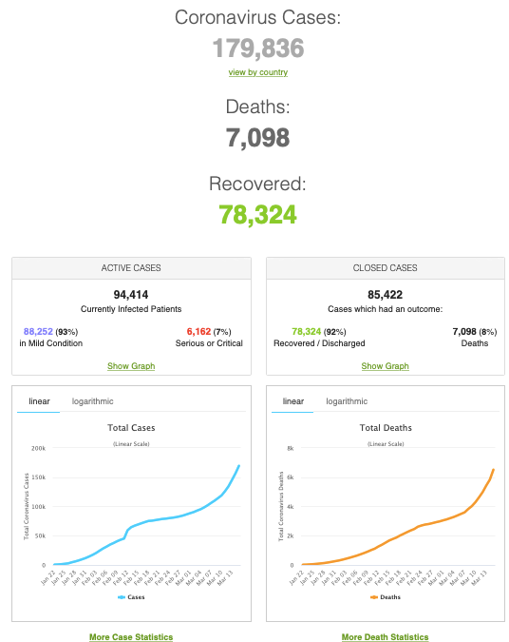
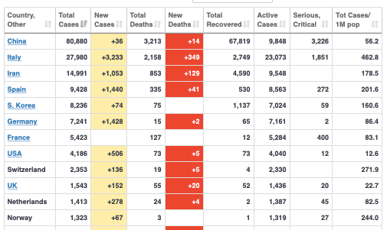
MOAR Coronavirus!
As of March 21: Things are not moving in the right direction:
What is the R0?
How can the R0 be changed?
How will the R0 change?
What is the asymptote share of the population?
What is the mortality rate?

Slide 54
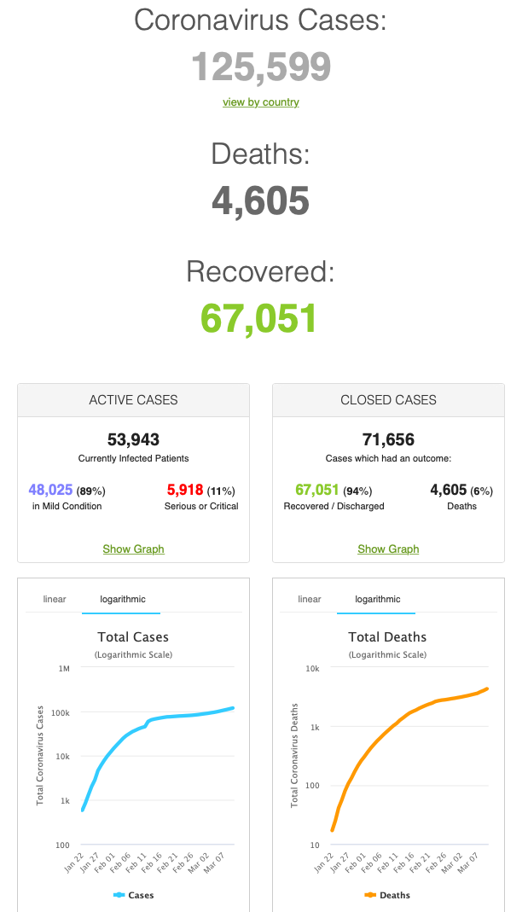
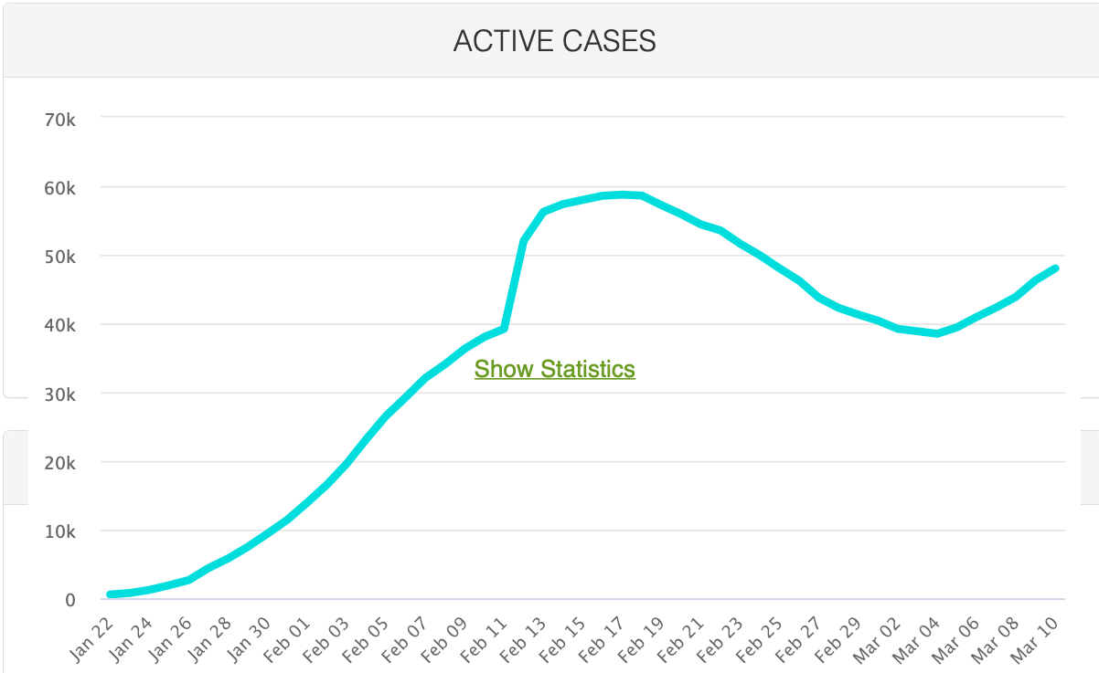
MOAR Coronavirus!
As of March 10: Things are not moving in the right direction:
What is the R0?
How can the R0 be changed?
How will the R0 change?
What is the asymptote share of the population?
What is the mortality rate?

Slide 55
Notes

Slide 56
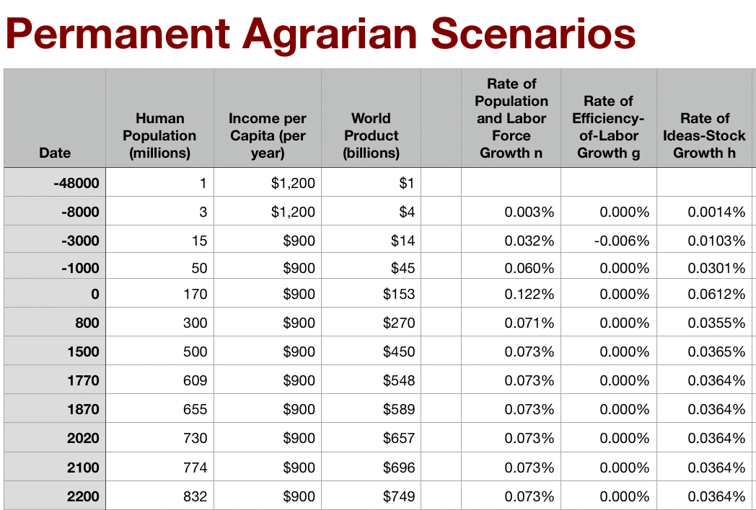
Permanent Agrarian Age World
What if there had been no Commercial Revolution?
What would we have to eliminate from our world?
The New World & the Columbian Exchange
Merchant republics & constitutional monarchies
Printing as transformative for intellectual life?
Is this plausible?
Rate of ideas growth settles at 0.035%/yr = 0.7%/generation
Doubling time of 2000 years
World today of 1/10 population, $2.50/day
Population growing at glacial pace

Slide 57
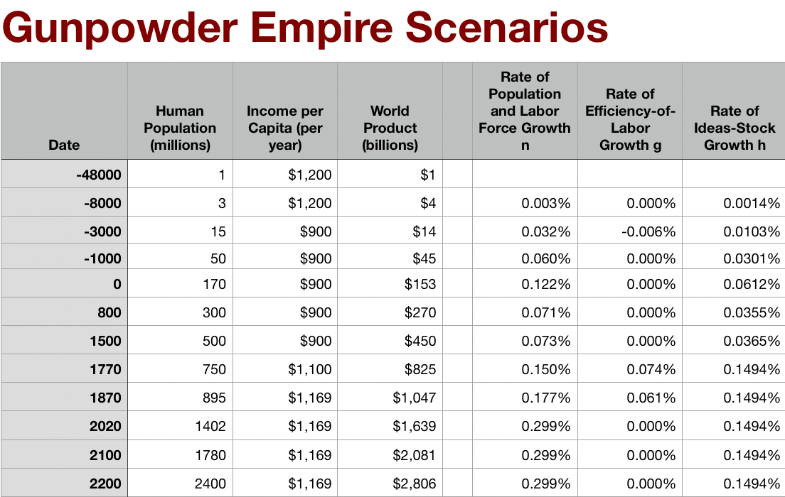
Gunpowder Empire World
What if things had stuck at the Commercial Revolution?
What would we have to eliminate from our world?
Coal or the British Empire
Science, tinkering, and nature manipulation?
Is this plausible?
Global rate of ideas growth of 0.15%/yr = 4%/generation, broadly shared
Doubling time of 500 years
World today of 1/5 our population, $3/day

Slide 58
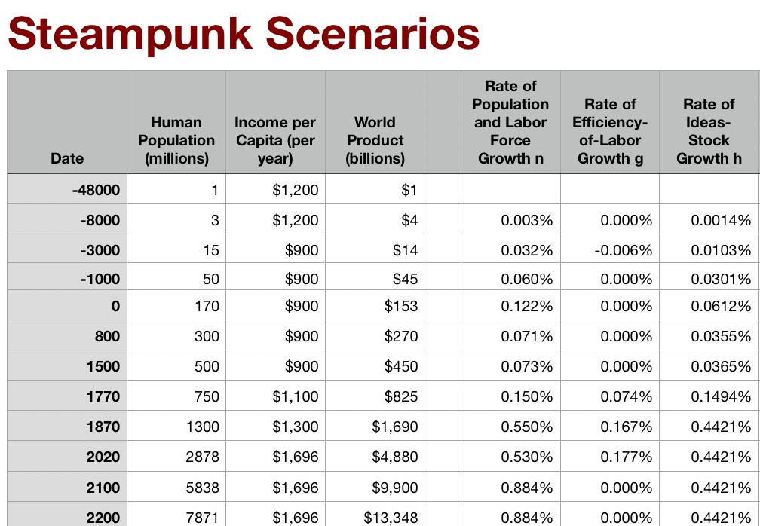
Steampunk World
What if there had been no Industrial Revolution?
What would we have to eliminate from our world?
Post-1870 speedup of STEM labor force growth
Industrial research lab to rationalize & routinize & modern corporation to deploy ideas
Globalization?
Is this plausible?
Stepping-on-toes & low-hanging-fruit
Arguments that it was inevitable lead to expectations of further growth accelerations—which we have not had
World settles at ideas growth of 0.44%/yr—12%/generation
doubling time of 150 years
World today of 2.7 billion, $5/day
World reaches today’s population in 2200

